Slide 1

i v i l i t y
Lorena Huang Liu
Jessica Xu
Katie Stockdale
Steven Qian
-
Behavioral Studio, CA: Wending Lu

Slide 2
Presentation Outline
3 Tasks
  Simple: Visual Feedback
  Moderate: Indicators of Agitation
  Complex: Keyphrase Improvement
Feedback & Changes
Hi-Fidelity Prototype: Simple Task

Slide 3
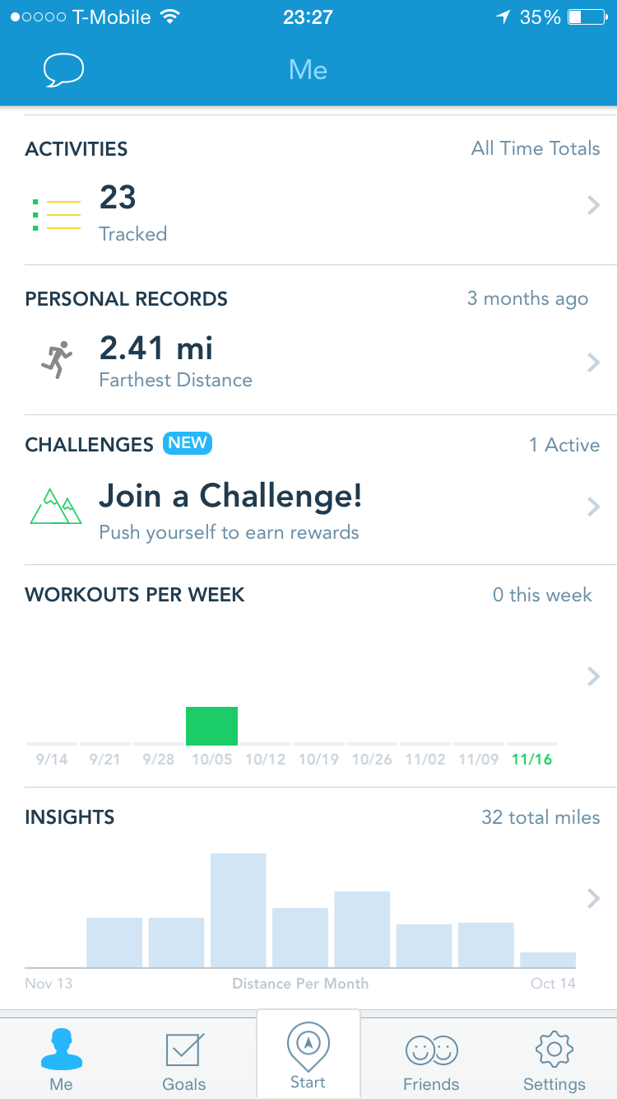
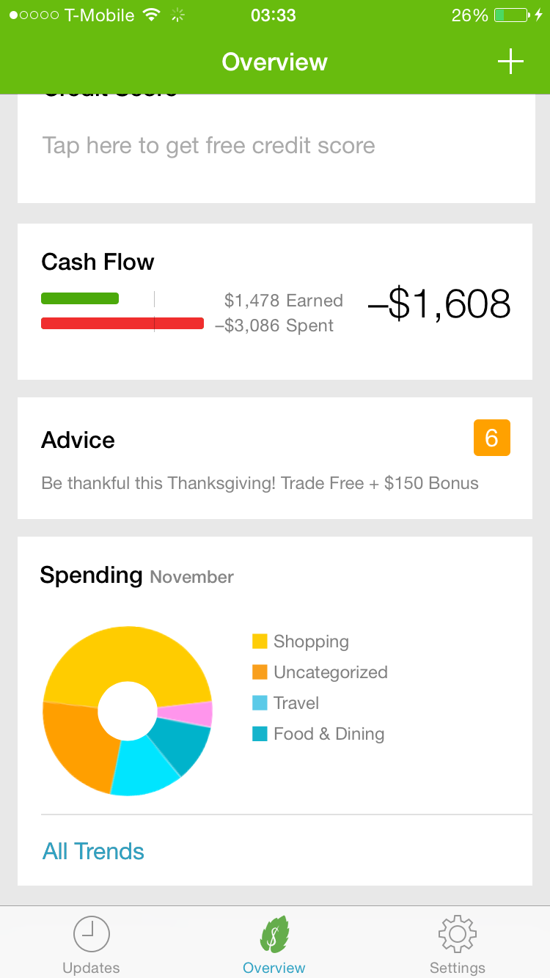
Task 1 (Simple): Visual Feedback
Notes:
Provide cumulative feedback over the course of different time periods
Based on volume and speech rate data, purely objective
Based on times violated instead of complicated units that people don’t understand

Slide 4
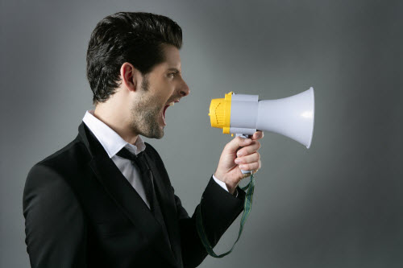
Task 1 (Simple): Visual Feedback
Voice Volume
Speech Rate
Notes:
Provide cumulative feedback over the course of different time periods
Based on volume and speech rate data, purely objective
Based on times violated instead of complicated units that people don’t understand

Slide 5
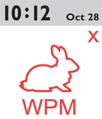
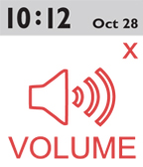
Task 2 (Moderate): Indicators of Agitation
Real-time responses
  Voice volume
  Rate of speech
Notes:
Based on volume and speech rate
Responds in real time to the user’s speech volume relative to the background noise
Respond in real time to the user’s speech rate
Notifications if it crosses a certain threshold

Slide 6

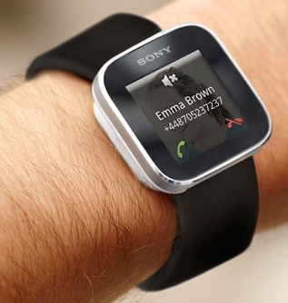
Task 3 (Complex): Keyphrase Improvement
Notes:
Predetermined key phrases that will already be programmed into the system
Whatever, I don’t care, This is stupid
User can also enter their own phrases through voice commands
Not in real-time, later feedback
Challenge: fit into smartwatch

Slide 7
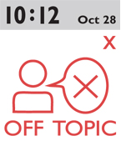
Feedback & Changes
✕
No “off-topic” feature

Slide 8
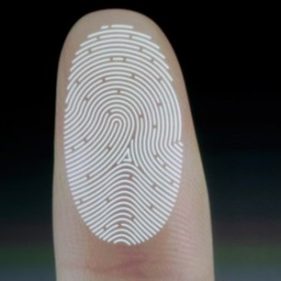
Feedback & Changes
Login Screen

Slide 9
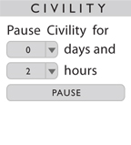

Feedback & Changes
Clear “Cancel” button

Slide 10
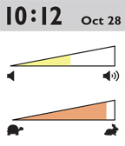
Feedback & Changes
Change icons

Slide 11
Hi-Fi Prototype
Task 1 (Simple): Visual Feedback
Website
  http://stanford.edu/class/cs147/projects/behavior/civility/

Slide 12
Questions?

